Slide 1
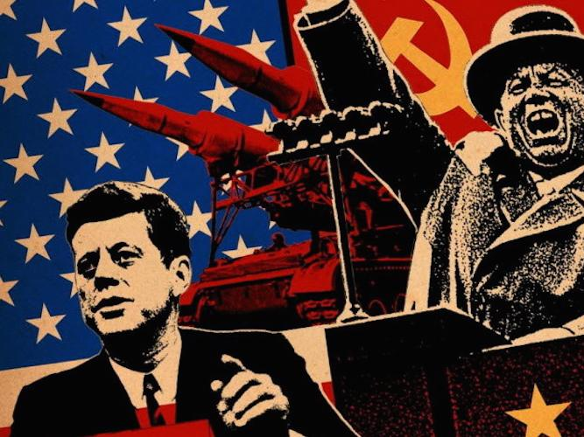
Origins of the Cold War
USA vs. USSR

Slide 2
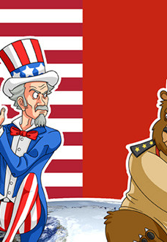
Stage is set for 46-year Cold War
United States
  capitalism & free enterprise
  enormous industrial capacity
  largest Navy and Air Force and only A bomb
  believed that American security depended on stability in Europe and Asia
United Soviet Socialist Republic (USSR)
  Communism
  wanted to reshape the world in its own image

Slide 3
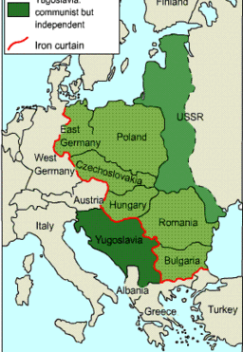
Origins of the Cold War
Unclear at Yalta conference how the Eastern European countries would be divided
Despite Stalin’s promise of free elections, Eastern European countries became Soviet “satellite states”
Soviets established pro-communist governments in Poland, Romania, and Bulgaria

Slide 4
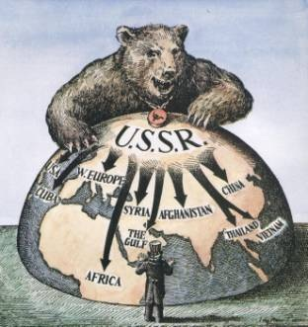
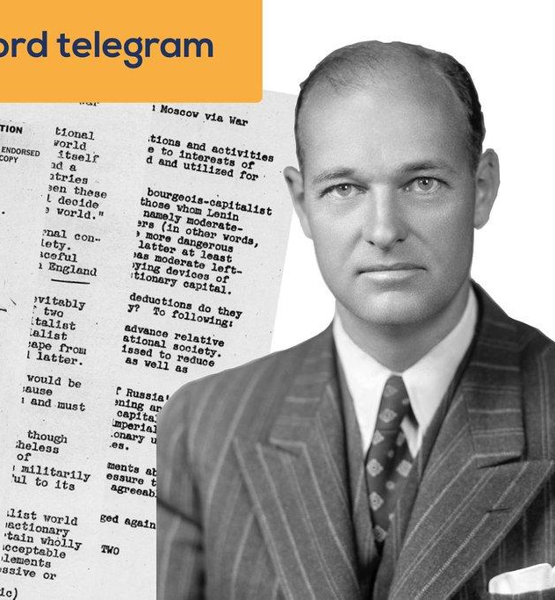
“Containment” Policy
George Kennan, American diplomat & Soviet expert
  created a “blueprint” for a new American policy through an 8,000-word “Long Telegram”
  develops the policy of containment
Goal was to keep communism within its existing borders
Kennan felt USSR would not risk a war with US

Slide 5
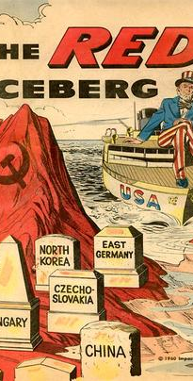
The Iron Curtain
Former Prime Minister Winston Churchill-coined the phrase “iron curtain” in a speech in Missouri
The “iron curtain”-divided free West from the communist east in Europe
March, 1947- Truman announces that the U.S. and the Soviet Union are engaged in a global conflict

Slide 6
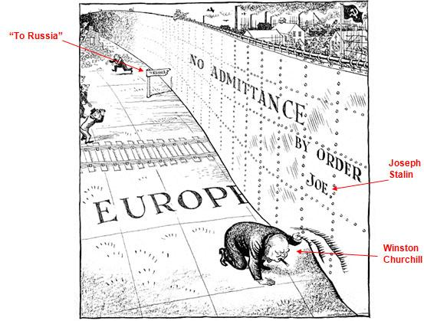

Slide 7
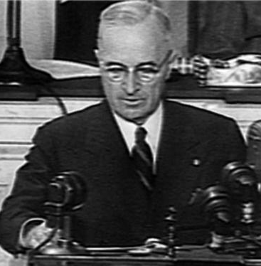
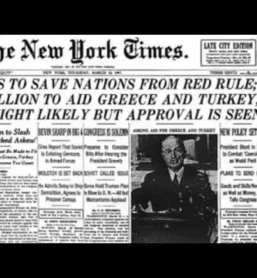
The Truman Doctrine
Of the countries battling communist uprising, Truman is particularly concerned with Greece & Turkey
Did not want to retreat to isolationism again
Congress supported Truman and supplied $400 million in aid to Greece & Turkey
Truman Doctrine – Truman’s promise to help nations struggling against communism

Slide 8
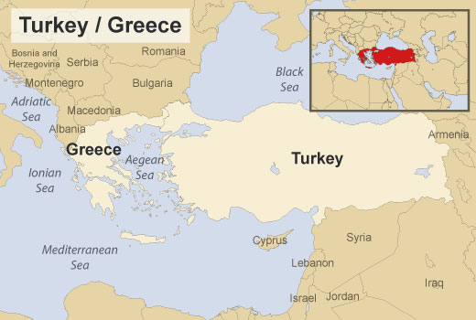
Using this map, discuss why Greece and Turkey were important strategic locations to Truman.

Slide 9
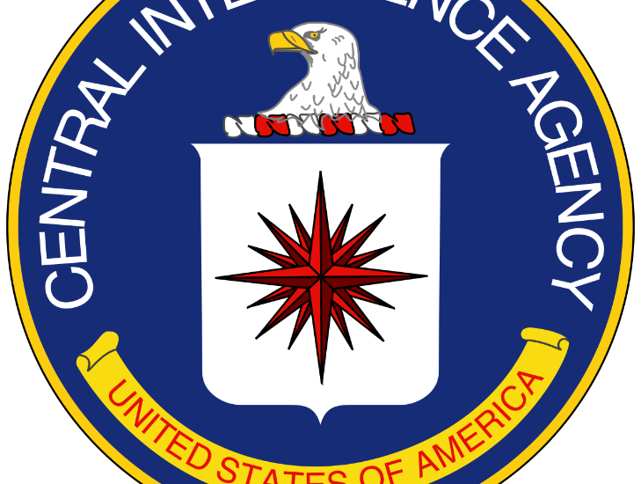
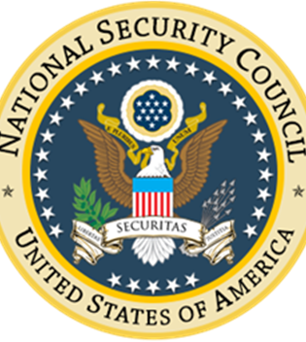
Truman Doctrine
Truman’s rhetoric-became the “guiding spirit of American foreign policy”
Sets a precedent for U.S. support of undemocratic, anti-communist regimes and creation of military alliances against the Soviets.
National Security Council and Central Intelligence Agency created to protect national security

Slide 10
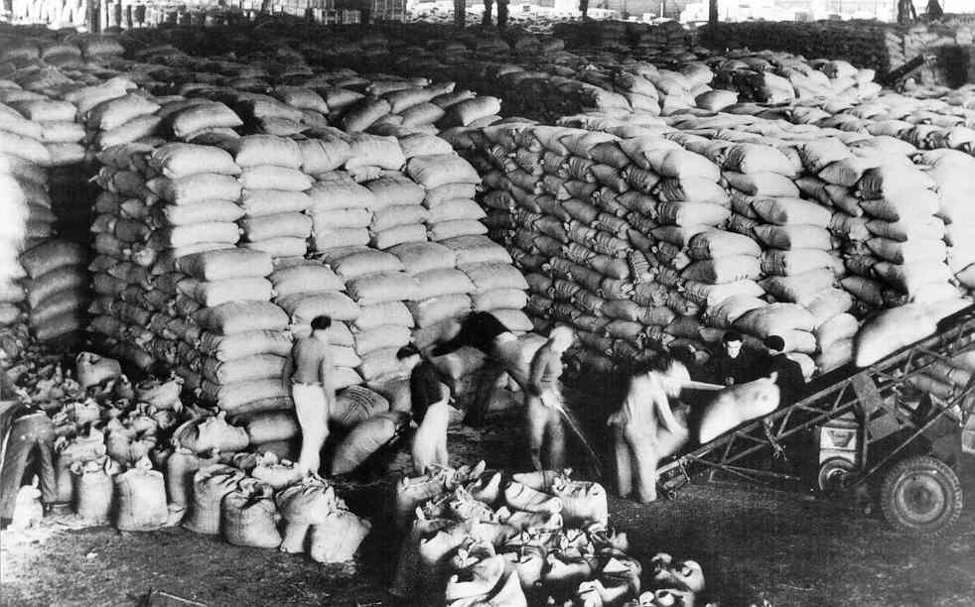

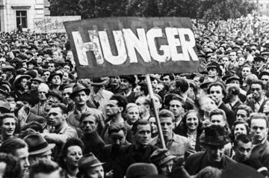
The Marshall Plan
In Western Europe, many people suffered from lack of food, fuel and medical supplies
Sec. of State George Marshall unveiled a plan to help Western Europe recover economically
Marshall Plan – over 4 years, U.S. gave $14 billion in grants and loans to nations in Western Europe
Solidified the division of Europe - Soviets would not participate

Slide 11
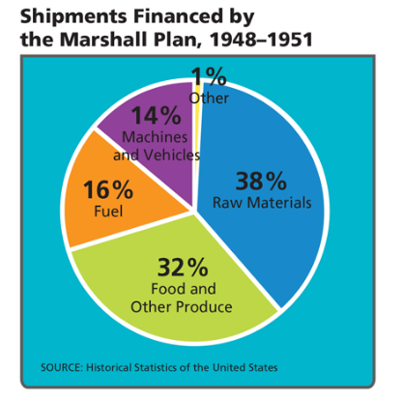
Marshall Plan chart

Slide 12
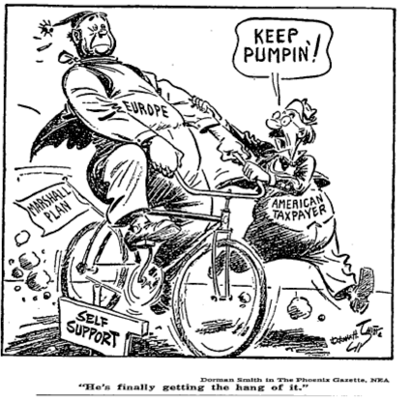

Slide 13
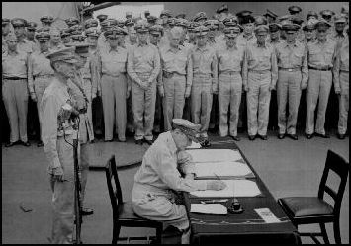
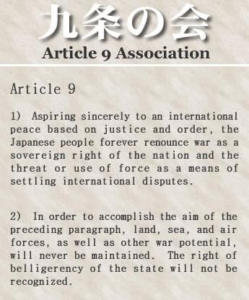
The Reconstruction of Japan
General Douglas MacArthur
  administered U.S. occupation until 1948
Wrote a new constitution
  women could vote
  Japan could never wage war-maintain small military force for self-defense (Article 9)
U.S. supervised the economic recovery
By 1950s-Japan’s economy was booming

Slide 14
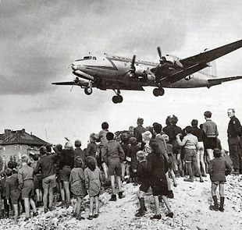
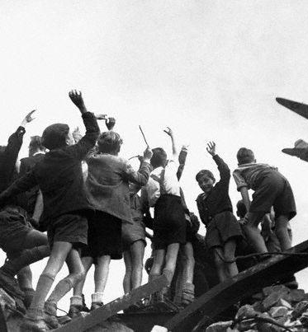
Berlin Airlift – “Operation Vittles”
Germany was divided into 4 zones, but Berlin was also split
Life in West Berlin much more prosperous than East Berlin
Stalin wanted West Berlin too, so he creates a blockade trying to cause West Berlin to fall to communists
U.S. & Britain supplied West Berlin through a massive airlift that almost a year
Showed how far U.S. would go to support containment

Slide 15
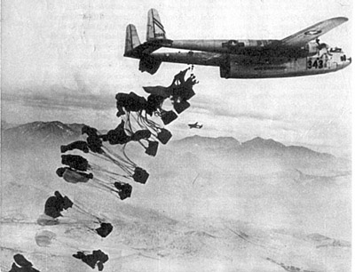
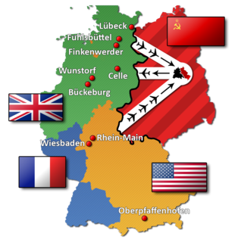
Berlin Airlift (June 1948 – May 1949) – fast facts
Britain & US supply planes took off every 30 seconds supplying food, medical supplies, clothing & toys
500 flights per day
5,000 tons a day of supplies
2.3 tons of cargo overall
Overall 300,000 flights

Slide 16
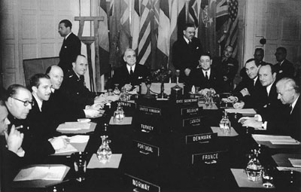
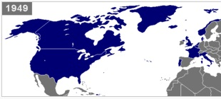
North Atlantic Treaty Organization (NATO)
1949, Soviets tested their first A-bomb
In 1949, an alliance formed to counter Soviet expansion
10 Western European countries, U.S. and Canada formed NATO
Still in existence today

Slide 17
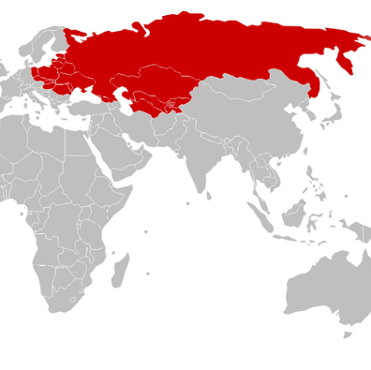
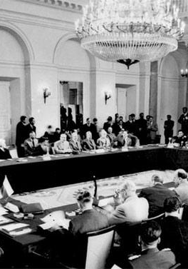
Warsaw Pact
In response to NATO, the USSR & satellite states formed the Warsaw Pact
Pledged to defend each other if one was attacked
USSR still exerted all control

Slide 18
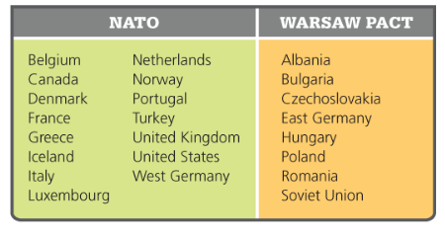
Cold War Alliances, 1955

Slide 19
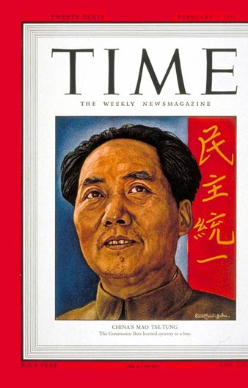
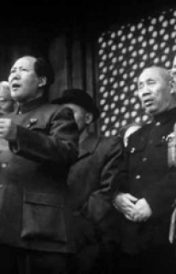
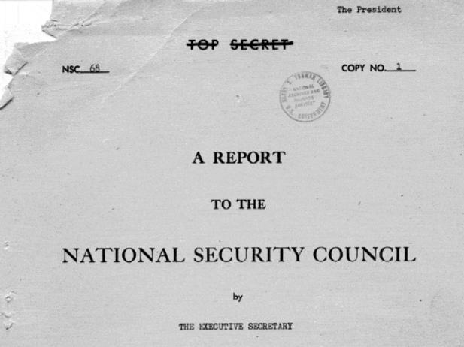
The Growing Communist Challenge
1949, Communists in China led by Mao Zedong won a civil war
Truman did not recognized the new People’s Republic of China, refused to seat them in the U.N.
Recognized the exiled regime in Taiwan as China’s legitimate government
National Security Council-1950
  passed NSC-68- depicted the Cold War as an epochal conflict between the “idea of freedom” and the “slavery’ of the Soviets
Increased military spending

Slide 20
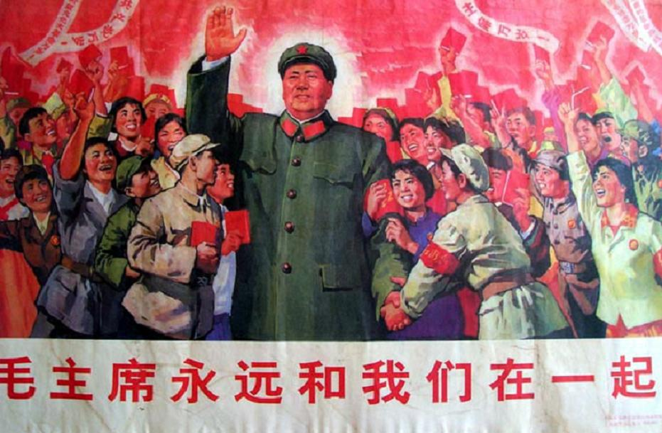

Slide 21
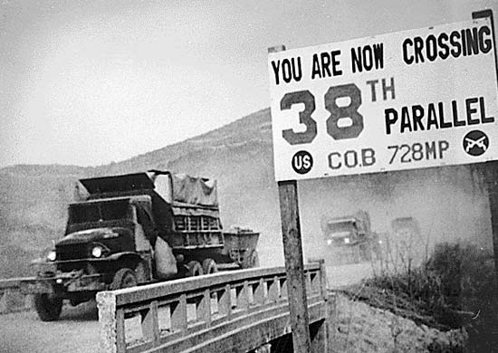
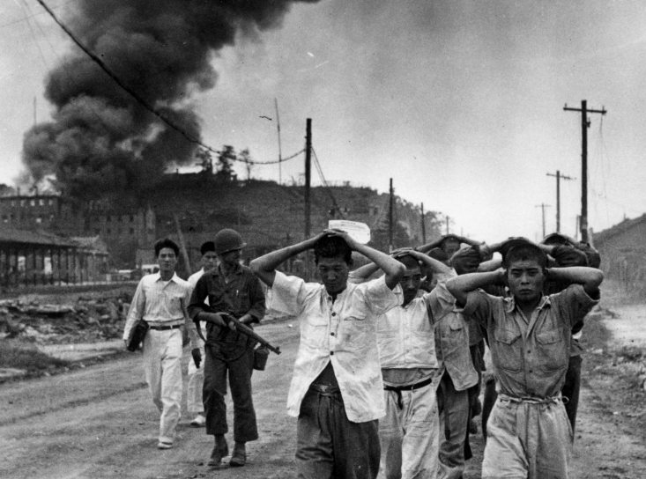
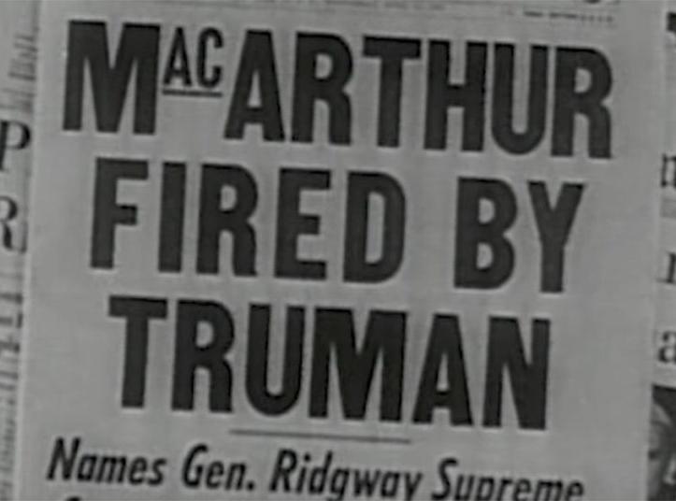
The Korean War
Korea had been divided into Soviet and American zones
  Communist in the North and anti-communist in the South
June 1950-North Korea invaded the south
General Douglas MacArthur (sent by Truman) -U.S. occupied most of North Korea
1950-Chinese troops crossed the border and pushed U.N. troops back down the peninsula
MacArthur wanted to use nuclear weapons-Truman said NO!
MacArthur criticized Truman and was removed from command
38th parallel became dividing point
1953 armistice signed, no formal peace treaty

Slide 22
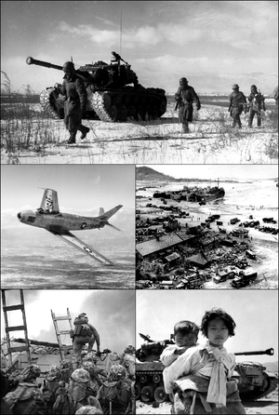
Korean War Effects
33,000 Americans, 1 million Korean soldiers, 2 million civilians and hundreds of thousands of Chinese troops died
Cold War now was global
U.S. (including Japan) became known as the West or the “Free World”
U.S. formed more military alliances in Southeast Asia and the Middle East
Surrounded the Soviet Union and China
SEATO-Southeast Asia
CENTO-Middle East

Slide 23
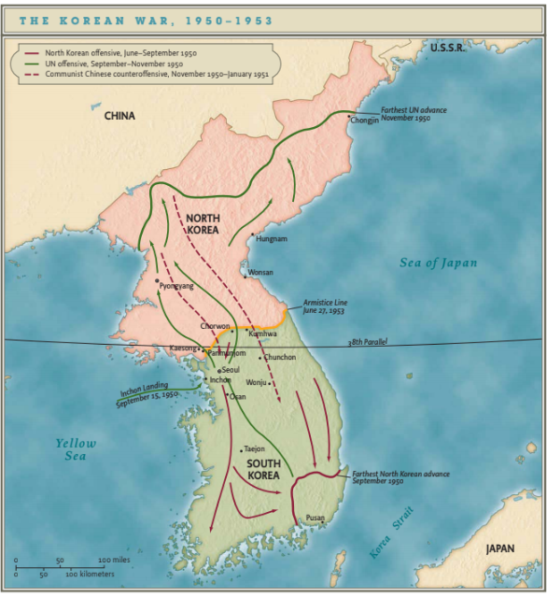

Slide 24
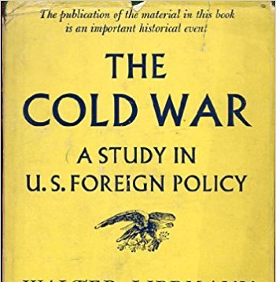
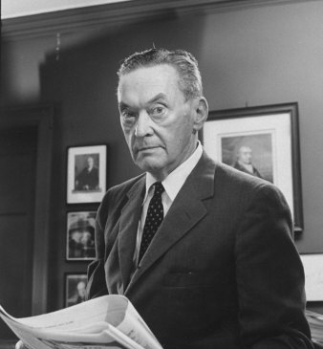
Cold War Critics
George Kennan (containment policy)-argued that U.S. leaders should avoid ideological decisions and view international crises on a case by case basis
Walter Lippman-one of the nation’s most prominent journalists-objected to turning our foreign policy into an “ideological crusade”
  Introduces the term “Cold War” for the first time.
  U.S. should not constantly intervene abroad-some rebellions were sparked by domestic issues, not Soviet subversion.

Slide 25
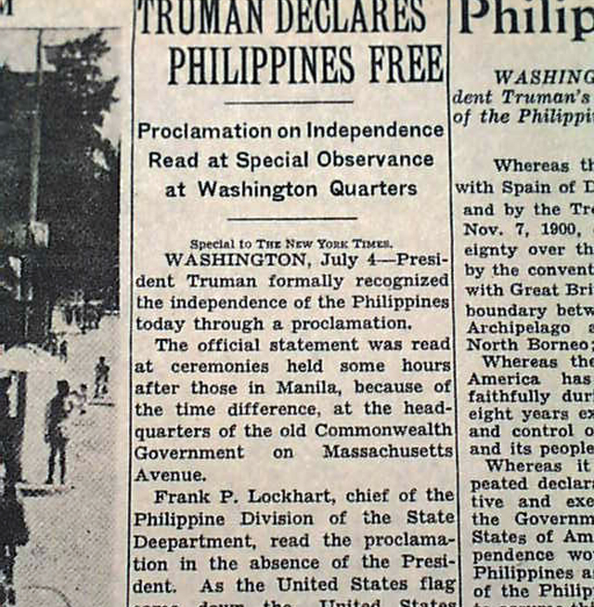
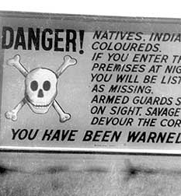
Imperialism and Decolonization
Anti-colonial movements-used Declaration of Independence to make claims for self-government
Some liberals and black leaders wanted Truman to promote decolonization
1946-Philippines gain independence
Britain and France-wanted to keep colonial possessions in Africa and Asia
Geopolitical and economic interests shaped American foreign policy
As long as a nation was “anti-communist”-it was considered a member of the Free World
South Africa-considered as an ally-although an apartheid regime kept whites in power and suppressed the black population.

Slide 26
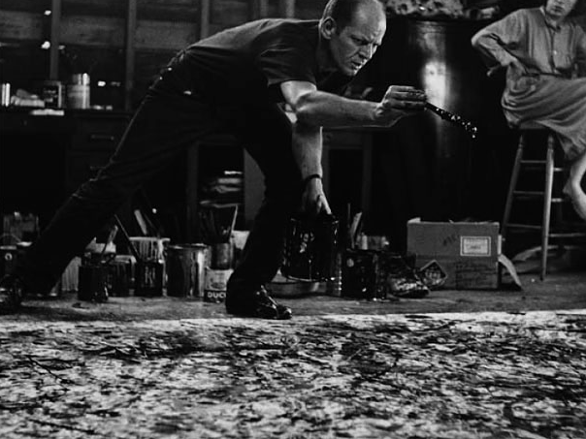
The Cultural Cold War
Culture and history were mobilized in the Cold War
Federal government pressed Hollywood to make anti-communist films
CIA and Defense Department patronized the arts-
CIA funded Jackson Pollock-canvasses created by dropping and splashing paint-said to embody cultural freedoms absent in socialist nations

Slide 27
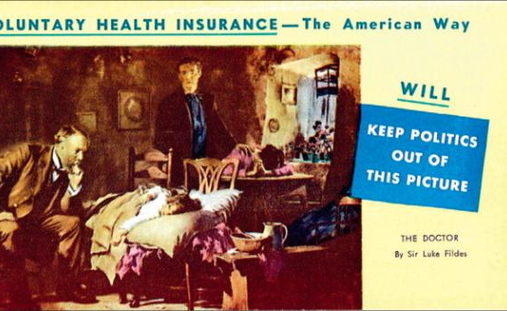
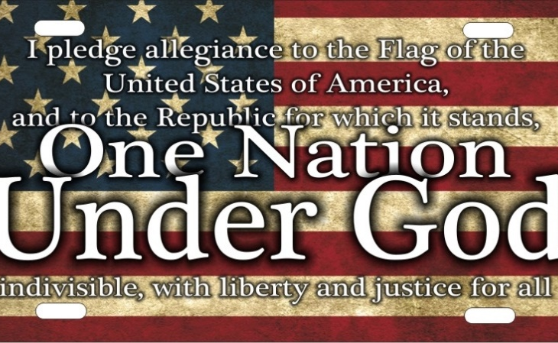
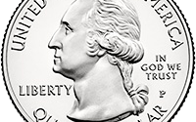
Freedom and Totalitarianism
Totalitarianism-described the Soviet Union and its allies
Belief that powerful governments were the greatest threat to freedom
American Medical Association-launched a campaign against Truman’s proposal for national health insurance-called it socialized medicine
1954-Congress added “under God” to the Pledge of Allegiance since Soviets opposed organized religion
1956 – “In God We Trust” replaced “E Pluribus Unum” as official motto of the United States currency

Slide 28
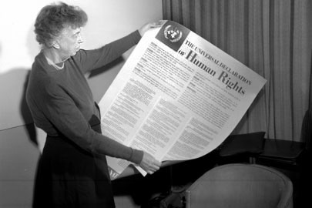
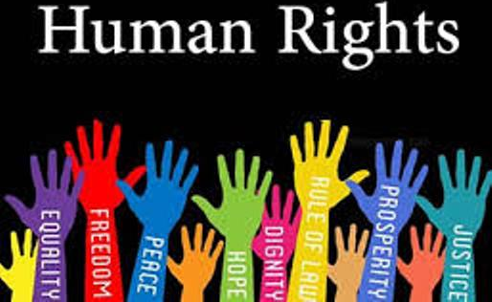
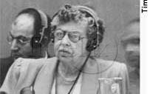
The Rise of Human Rights
Universal Declaration of Human Rights-adopted by the UN-all people should have basic rights
  freedom of speech and religion, free from arbitrary government, enjoy social and economic entitlement
Document could not be enforced anywhere - goal was the governments were accountable for the way they treated their citizens
Ambiguities of Human Rights –
  U.S. and Soviet Union resisted the creation of a mechanism to enforce the UDHR
  feared outside interference in domestic and foreign policy
1992-Congress ratified the part of the UDHR that covers “Civil and Political Rights”

Slide 29
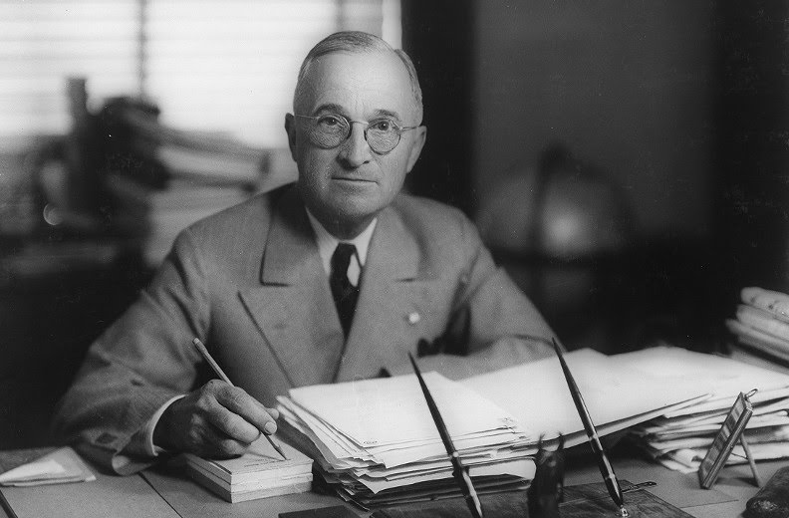
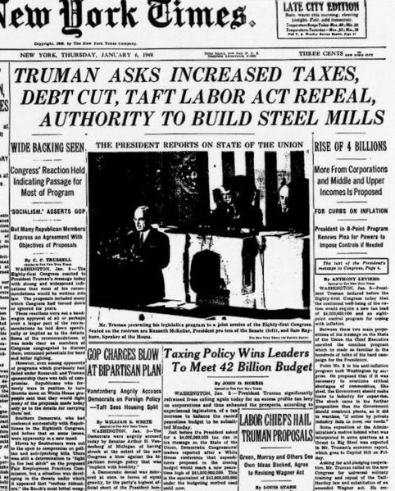
The Fair Deal
12 million men returned from the war-some found civilian life difficult, others used their GI Bill benefits to build or buy homes, start small businesses and go to college
2 million women workers were replaced by returning soldiers
Government dismantled wartime industries
Set price controls-led to inflation
Fair Deal-improve the social safety net and raise living standards

Slide 30
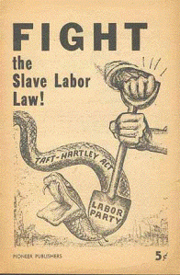


The Republican Resurgence &
Post-War Strike Wave
Postwar Strike Wave –
  Operation Dixie – AFL and CIO brought unions to the South
  Reduced overtime and inflation led to strikes
1946-middle class voters-alarmed by labor strikes-voted Republican
Republicans gained control of both houses
Taft Hartley Act-1947
  President could suspend strike
  outlawed the closed shops
  forced union officials to take a loyalty oath
Made it more difficult to bring unorganized workers into unions

Slide 31



Postwar Civil Rights
Truman-embraced civil rights for African Americans in his first term
Fair employment practices-adopted by many states
NAACP-raised number of black voters in the South
1947-sports started to desegregate when Brooklyn Dodgers added black athlete Jackie Robinson to the team
1948-Truman desegregated the military
  military (Executive Order 9981) became the first large integration institution in American history

Slide 32



The Dixiecrat and Wallace Revolt
1948-Democrats in the South formed the States Rights’ Democratic Party (aka “Dixiecrats”)
  nominated Strom Thurmond for president
  Party called for complete segregation of the races
Progressive party
  nominated Henry Wallace for president
  wanted to expand the welfare state and denounced segregation
  Wallace advocated trade with Soviet Union-supported by the socialists and communist
Truman stated that a vote for Wallace was a vote for Stalin

Slide 33


The 1948 Campaign
Truman’s main challenger was Republican candidate Thomas A. Dewey
Truman criticized Congress for its inaction and recycled New Deal critiques of Wall Street
Last election before television
Widely predicted Dewey victory-Truman won
For the first time since 1868-blacks influenced the outcome

